Slide 1
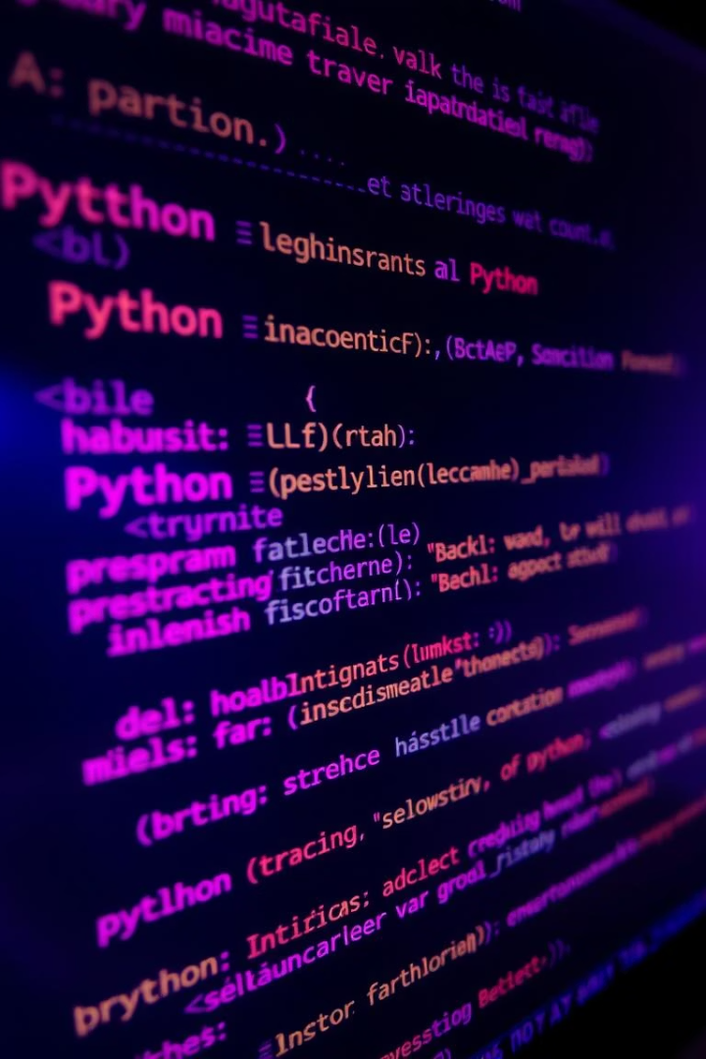

Name : Roshan Shinde
Roll No: CS8-18
PRN : 202401120022
Python String Operations: Mastering Text Manipulation
Unlock the power of Python strings. Learn to manipulate text effectively. Master essential techniques. Enhance your programming skills.
Notes:
1

Slide 2

Introduction to Strings in Python
Strings are immutable Unicode sequences. Strings are created using single, double, or triple quotes. They are a fundamental data type for text processing. Strings support multiple built-in methods for manipulation.
Notes:
2

Slide 3
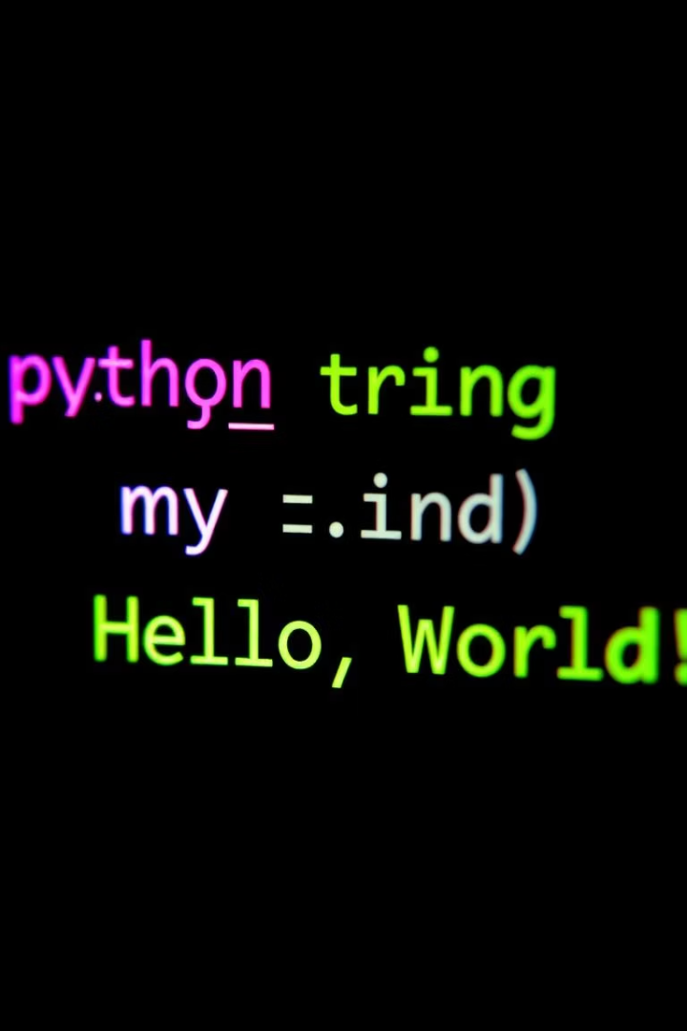
String Creation and Basic Properties
1
String Creation
2
Indexing and Slicing
Multiple ways to create strings. Choose the right method for your needs.
Access specific characters or substrings with indexing and slicing.
3
Immutability
Understand that strings are immutable. Learn how this affects operations.
Notes:
3

Slide 4
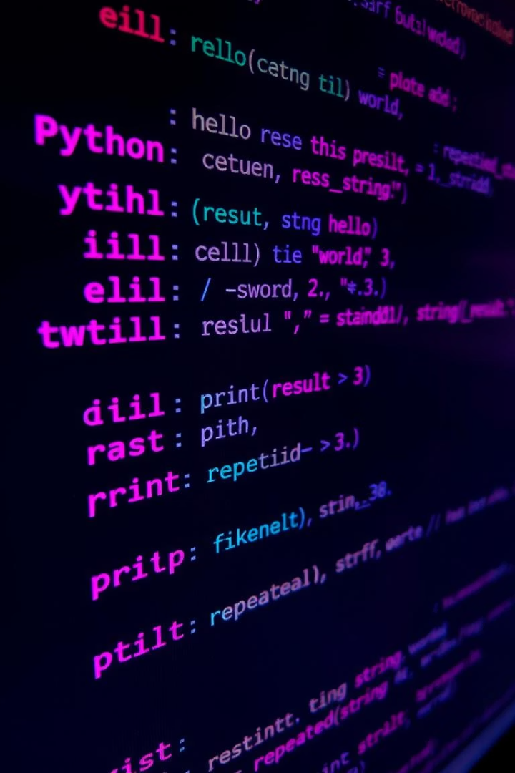



String Concatenation and Repetition
Concatenation
Use the + operator to combine strings into one.
Repetition
Repeat strings with the * operator.
Joining
Join multiple strings efficiently.
Notes:
4

Slide 5
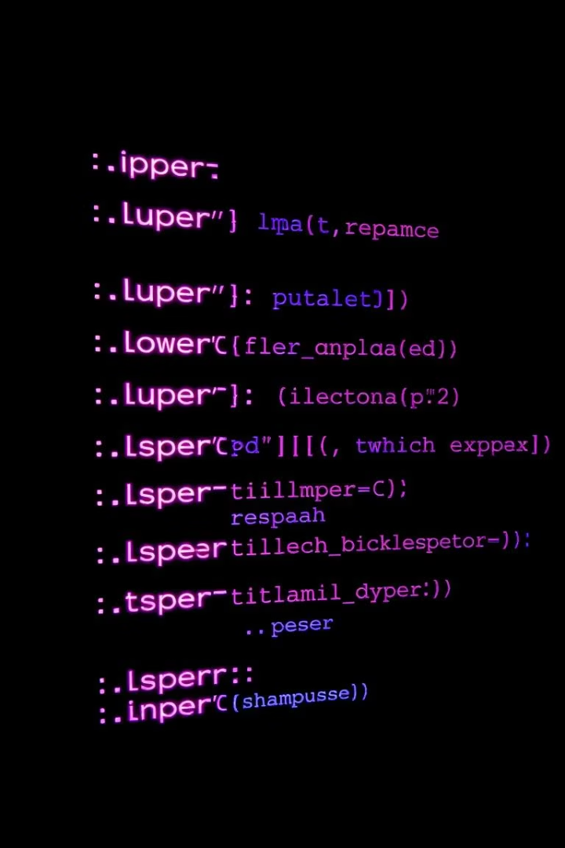




String Methods for Modification
Case Conversion
.upper() and .lower() methods.
Whitespace Removal
.strip(), .lstrip(), .rstrip() methods.
Character Substitution
.replace() for replacing characters.
String Separation
.split() and .join() operations.
Notes:
5

Slide 6
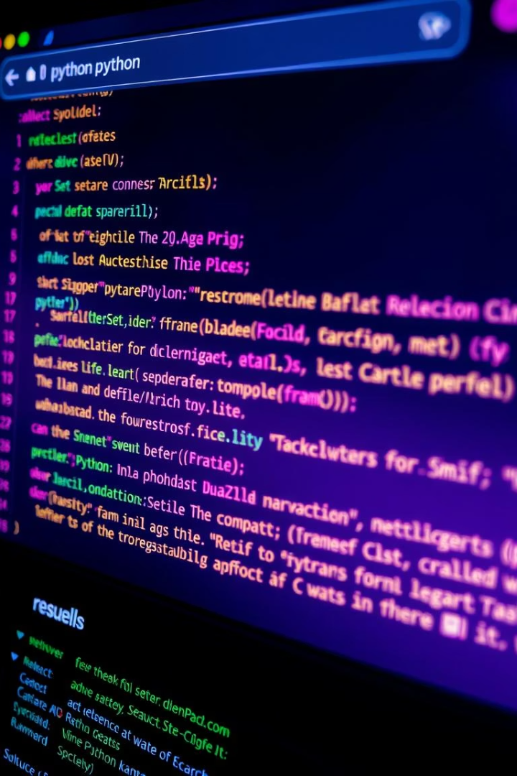
String Searching and Checking
1
Substring Location
Use .find() and .index().
2
Prefix and Suffix
.startswith() and .endswith().
3
Content Check
.isalpha(), .isdigit() methods.
Notes:
6

Slide 7



Advanced String Formatting
f-strings
1
Formatted string literals.
.format()
2
Format method.
Alignment
3
String alignment and padding.
Notes:
7

Slide 8

Practical String Manipulation Examples
Real-world Use Cases
Data Cleaning
Explore various applications of string manipulation.
Clean and preprocess data using string techniques.
Text Processing
Process text for analysis and extraction.
Notes:
8

